Slide 1
Binus Online Learning Computer Science
Dr. Suharjito, S.Si. MT
HOD – PJJ Computer Science

Slide 2

Selamat !!!
Komunitas Binusian
Alumni > 100 ribu

Slide 3
Visi dan Misi PJJ – CS?

Slide 4
VISI PJJ CS
Menjadi program pendidikan jarak jauh pilihan dalam Ilmu Komputer yang berfokus pada pengembangan solusi perangkat lunak kreatif untuk industri, diakui secara internasional, terdepan dalam berinovasi dan menghasilkan lulusan dengan kualifikasi internasional.

Slide 5
MISI PJJ CS 
Mendidik siswa dengan pengetahuan dasar dan lanjut, dengan keterampilan dan praktik dalam pengembangan perangkat lunak khusus pada teknologi basis data, sistem intelijen, jaringan, multimedia dan pengembangan game dengan menyediakan lingkungan belajar yang sangat baik, menggunakan penelitian dan kolaborasi dengan industri global
Mempersiapkan mahasiswa untuk menjadi pemimpin dan profesional TIK yang cerdas dan menjadi pengusaha di pasar global atau melanjutkan studi
Mengarahkan mahasiswa & dosen untuk menjadi talenta kreatif dan bernilai tambah dalam ilmu komputer dengan menciptakan lingkungan yang sesuai agar dapat bersaing di tingkat internasional
Memberikan layanan profesional TI dengan penekanan dalam penerapan pengetahuan dalam pengembangan masyarakat
Berbagi pengetahuan aplikatif yang berkaitan dengan ilmu komputer untuk peningkatan kualitas hidup masyarakat Indonesia dan internasional
Notes:
specialized in database technology, intelligence system, networking or multimedia and game development

Slide 6
Tujuan Program PJJ CS
Untuk memberikan siswa dengan dasar pengetahuan yang kuat tentang matematika, prinsip-prinsip algoritma, ilmu komputer dan etika yang akan dibutuhkan dalam praktik Teknologi Informasi
Untuk memberikan siswa keterampilan dalam menerapkan prinsip-prinsip desain dan pengembangan sistem perangkat lunak dengan menggunakan aplikasi teknologi database, sistem intelijen, jaringan dan multimedia
Untuk mempersiapkan siswa dengan kemampuan agar tetap up-to-date dengan tren Teknologi Informasi terkini, perkembangannya, dan dunia industri
Untuk mempersiapkan siswa dengan kemampuan dalam pemecahan masalah dan keterampilan komunikasi yang baik untuk dapat bekerja sebagai individu atau dalam tim di lingkungan Teknologi Informasi

Slide 7
Graduate Competency
Mampu Membuat Rancangan Aplikasi piranti lunak dengan menerapkan prinsip-prinsip perancangan system basis data untuk memecahkan masalah terstruktur dan semi terstruktur.
Mampu merancang solusi aplikasi piranti lunak berdasarkan analisis permasalahan yang dapat diselesaikan dengan pendekatan terstruktur dalam bidang informatika.
Mampu melakukan pengkajian tren teknologi terbaru dalam bidang informatika untuk memberikan alternative solusi pengembangan piranti lunak.
Mampu berpikir kritis melalui prosedur kaidah ilmiah (Critical Thinking and Scientific approach) berdasarkan teori matematika dasar dan ilmu komputer.
Mampu merancang strategi pemecahan masalah dengan menggunakan pendekatan komputasi.
Cakap menggunakan Teknik dan perangkat komputasi (Technique and tools for computing practice) yang relevan dalam mempelajari area ilmu komputer untuk meningkatkan produktifitas.
Mampu menunjukkan keterampilan yang terkait dengan pengembangan dan penerapan konsep-konsep informatik.
Mampu bekerja sama secara multidisiplin dalam menyelesaikan berbagai konteks permasalahan.

Slide 8
Prospek Karir Lulusan PJJ – CS?

Slide 9
Prospective Career of the Graduates
S/W Developer
System Support & Network Administrator
System Engineer
Database Administrator
Web Developer/Designer
IT Technopreneurship
Application Architecture
Big Data Architecture
IT Consultant
Network Specialist
Mobile App Developer
Data Scientist
Cloud Comp Specialist

Slide 10
Apa saja yang diperoleh selama belajar di Binus Online Learning?

Slide 11
BINUS Online Learning SMA-S1 Student Success Journey
Mhs BOL mengikuti kurikulum BINUS Online Student Success Journey, dengan 80 cu (Core Subject) + 40 cu (Specific Program) + 20 cu (Enrichment program) + 6 cu (Thesis)
20 cu
Enrichment program
20 cu
Free Electiive course program
PILIHAN
80 cu
study program core subject
40 cu
SPESIFIK
20 cu
enrichment program
20 cu
Minor program
NOTE : setiap MK-BOL @ 4 cu
6 cu
thesis
LAYANAN ADMISI
BINUS Graduate Profile
LAYANAN ALUMNI
1
2
3
4
5
6
7
8
BINUS Graduate Development Program
80 point orientasi + 30 point international experience + 20 point industrial sharing
Career Development Program
Orientasi

Slide 12
BINUS Online Learning D3-S1 Student Success Journey
Mhs mengikuti kurikulum BINUS Online Learning, dengan 60 cu (Core Subject) + 20 cu (Enrichment) + 60 cu (Pengakuan Credit Earning) + 6 cu (Thesis)
60 cu
CREDIT EARNING
20 cu
Enrichment program
20 cu
Free Electiive course program
PILIHAN
20 cu
enrichment program
20 cu
Minor program
60 cu
study program
core subject
6 cu
thesis
40 cu
SPESIFIK
20 cu
study program core subject
NOTE : setiap MK-BOL @ 4 cu
LAYANAN ADMISI
BINUS Graduate Profile
LAYANAN ALUMNI
1
2
3
4
5
6
7
8
BINUS Graduate Development Program
50 point orientasi + 20 point international experience + 10 point industrial sharing
Career Development Program
Orientasi

Slide 13
Bagaimana Model Pembelajaran PJJ – CS?

Slide 14
Model Pembelajaran
Week | 1/2 | 1 | 2 | 3 | 4 | 5 | 4/5 | 4/5 | 6/7 | 6 | 7 | 8 | 9 | 10 | 9/10 | 9/10
Sesi | 1 | 2 | 3 | 4 | 5 | 6 | 7 | 8 | 9 | 10 | 11 | 12 | 13 | 14 | 15 | 16
Mode | VC1 |  |  |  |  |  |  |  | VC2
 |  | SL1 | SL2 | SL3 | SL4 | SL5 |  |  |  | SL6 | SL7 | SL8 | SL9 | SL10
 |  | FD1 | FD2 | FD3 | FD4 | FD5 |  |  |  | FD6 | FD7 | FD8 | FD9 | FD10
 |  |  | TG1 | TG2 | TG3 |  |  |  |  |  | TG4 | TG5 | TG6
 |  |  |  |  |  | KUIS1 |  |  |  |  |  |  |  | KUIS2
 |  |  |  |  |  |  | VC | VC |  |  |  |  |  |  | F2F | F2F
Catatan: Ujian dilaksanakan pada minggu ke-11
VC = Video Conference; F2F = kuliah tatap muka (bisa vicon/ onsite)
SL = Self Learning; FD = forum diskusi
TG = tugas personal/kelompok;

Slide 15
Apa yang dipelajari PJJ – CS?

Slide 16
SMA-S1 Matakuliah Tahun #1
NO. | PERIOD | MATA KULIAH | SKS | STATUS
1 | 1-1 | COMP6599 Algorithm and Programming | 6 | Core Courses
2 | 1-1 | MATH6077 Discrete Mathematics | 4 | Core Courses
3 | 1-2 | COMP6124 Program Design Methods | 4 | Core Courses
4 | 1-2 | COMP6127 Algorithm Design and Analysis | 4 | Core Courses
5 | 1-2 | CHAR6019 Character Building: Pancasila | 2 | University Courses
 |  |  | 20
SMA-S1
NO. | PERIOD | MATA KULIAH | SKS | STATUS
6 | 2-1 | CHAR6020 Character Building: Kewarganegaraan | 2 | University Courses
7 | 2-1 | CPEN6214 Computer Networks | 4 | Core Courses
8 | 2-1 | COMP6600 Operating System | 4 | Core Courses
9 | 2-2 | COMP6601 Data Structures | 6 | Core Courses
10 | 2-2 | COMP6275 Artificial Intelligence | 4 | Core Courses
 |  |  | 20

Slide 17
SMA-S1 Matakuliah Tahun #2
NO. | PERIOD | MATA KULIAH | SKS | STATUS
11 | 3-1 | ENTR6081 Entrepreneurship | 4 | University Courses
12 | 3-1 | ISYS6508 Database System | 6 | Core Courses
13 | 3-2 | MATH6156 Calculus and Linear Algebra | 4 | Core Courses
14 | 3-2 | ENGL6163 English Professional | 4 | University Courses
15 | 3-2 | COMP6307 Human and Computer Interaction | 4 | Core Courses
 |  |  | 22
SMA-S1
NO. | PERIOD | MATA KULIAH | SKS | STATUS
16 | 4-1 | COMP6199 Software Engineering | 6 | Core Courses
17 | 4-1 | COMP6728 Research Methodology in Informatics | 4 | Core Courses
18 | 4-2 | COMP6618 Object Oriented Programming | 4 | Program Courses
19 | 4-2 | COMP6276 Compilation Techniques | 4 | Core Courses
20 | 4-2 | LANG6031 Indonesian | 2 | University Courses
 |  |  | 20

Slide 18
NO. | PERIOD | MATA KULIAH | SKS | STATUS
21 | 5-1 | COMP6620 Pattern Software Design | 4 | Program Courses
22 | 5-1 | COMP6305 Computer Security | 4 | Program Courses
23 | 5-2 | ISYS6332 Data Warehouse | 4 | Program Courses
24 | 5-2 | COMP6621 Web Programming | 4 | Program Courses
25 | 5-2 | ISYS6362 Database Design | 4 | Program Courses
 |  |  | 20
SMA-S1 Matakuliah Tahun #3
SMA-S1
NO. | PERIOD | MATA KULIAH | SKS | STATUS
27 | 6-1 | COMP6720 Data Science | 4 | Program Courses
27 | 6-1 | COMP6284 Code Reengineering | 4 | Program Courses
28 | 6-1 | CHAR6021 Character Building: Agama | 2 | University Courses
29 | 6-2 | COMP6617 Cloud Computing | 4 | Program Courses
30 | 6-2 | COMP6721 Mobile Programming | 4 | Program Courses
 |  |  | 18

Slide 19
SMA-S1 Matakuliah Tahun #4
NO. | PERIOD | MATA KULIAH | SKS | STATUS
31 | 7-1 | Enrichment Program (Minor -1 / Elective -1) | 4 | Enrichment Program
32 | 7-1 | Enrichment Program (Minor -2 / Elective -2) | 4 | Enrichment Program
33 | 7-2 | Enrichment Program (Minor -3 / Elective -3) | 4 | Enrichment Program
34 | 7-2 | Enrichment Program (Minor -4 / Elective -4) | 4 | Enrichment Program
35 | 7-2 | Enrichment Program (Minor -5 / Elective -5) | 4 | Enrichment Program
 |  |  | 20
SMA-S1
NO. | PERIOD | MATA KULIAH | SKS | STATUS
36 | 8-1 | COMP6328 Thesis | 0 | Final Project
 | 8-2 | COMP6288 Thesis | 6 | Final Project
 |  |  | 6

Slide 20
Daftar Matakuliah Minor
Course Code | Course Name | SCU
ACCT6384 | Accounting for Small Medium Enterprise | 4
MKTG6296 | Digital Marketing for Manager | 4
ISYS6619 | UX for Digital Business | 4
COMP6725 | Big Data Technologies | 4
ISYE6196 | Industrial Feasibility Analysis | 4
Enrichment Program

Slide 21
Distribusi MATAKULIAH: D3-S1

Slide 22
D3-S1 Matakuliah Tahun #1
NO. | PERIOD | MATA KULIAH | SKS | STATUS
1 | 1-1 | COMP6599 Algorithm and Programming | 6 | Core Courses
2 | 1-1 | MATH6077 Discrete Mathematics | 4 | Core Courses
3 | 1-2 | COMP6124 Program Design Methods | 4 | Core Courses
4 | 1-2 | COMP6127 Algorithm Design and Analysis | 4 | Core Courses
5 | 1-2 | CHAR6019 Character Building: Pancasila | 2 | University Courses
 |  |  | 20
D3-S1
NO. | PERIOD | MATA KULIAH | SKS | STATUS
6 | 2-1 | CHAR6020 Character Building: Kewarganegaraan | 2 | University Courses
7 | 2-1 | CPEN6214 Computer Networks | 4 | Core Courses
8 | 2-1 | COMP6600 Operating System | 4 | Core Courses
9 | 2-2 | COMP6601 Data Structures | 6 | Core Courses
10 | 2-2 | COMP6275 Artificial Intelligence | 4 | Core Courses
 |  |  | 20

Slide 23
D3-S1 Matakuliah Tahun #2
NO. | PERIOD | MATA KULIAH | SKS | STATUS
11 | 3-1 | ENTR6081 Entrepreneurship | 4 | University Courses
12 | 3-1 | Enrichment Program (Minor -1 / Elective -1) | 4 | Enrichment Program
13 | 3-1 | Enrichment Program (Minor -2 / Elective -2) | 4 | Enrichment Program
14 | 3-2 | Enrichment Program (Minor -3 / Elective -3) | 4 | Enrichment Program
15 | 3-2 | Enrichment Program (Minor -4 / Elective -4) | 4 | Enrichment Program
16 | 3-2 | Enrichment Program (Minor -5 / Elective -5) | 4 | Enrichment Program
 |  |  | 24
D3-S1
NO. | PERIOD | MATA KULIAH | SKS | STATUS
17 | 4-1 | COMP6199 Software Engineering | 6 | Core Courses
18 | 4-1 | COMP6728 Research Methodology in Informatics | 4 | Program Courses
19 | 4-1 | COMP6328 Thesis | 0 | Final Project
20 | 4-2 | LANG6031. Indonesian | 2 | University Courses
 | 4-2 | COMP6328 Thesis | 6 | Final Project
 |  |  | 22

Slide 24
Kenapa Binus ?

Slide 25
6 universitas terbaik di Indonesia dalam menghasilkan lulusan berkompetensi dan prospek kelulusan kerja tinggi versi QS World University Rankings:
Institut Teknologi Bandung (ITB): peringkat 301-500 dunia
Bina Nusantara University (Binus): peringkat 301-500 dunia
Universitas Diponegoro: peringkat 301-500 dunia
Institut Teknologi Sepuluh Nopember (ITS): peringkat 301-500 dunia
Universitas Gadjah Mada: peringkat 301-500 dunia
Universitas Indonesia: peringkat 301-500 dunia
Sumber Kompas.com , oct 2019

Slide 26
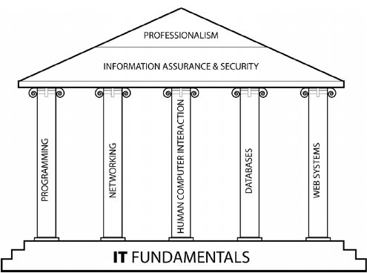
Curriculum berstandar internasional

Slide 27
Mata Kuliah Pengendalian Mutu S1
Courses which are labeled as “quality-controlled examination” have a minimum grade to be passed. Max. Length of Study are 7 years!!!
No | Kode | Mata Ujian | Grade Min
1 | CHAR6019 | Character Building: Pancasila | B
2 | ENTR6081 | Entrepreneurship | C
3 | COMP6124 | Program Design Methods | C
4 | COMP6601 | Data Structures | C
5 | COMP6199 | Software Engineering | C
6 | COMP6728 | Research Methodology in Informatics | C
7 | COMP6618 | Object Oriented Programming | C
8 | COMP6621 | Web Programming | C

Slide 28
Mata Kuliah Pengendalian Mutu Ext
Courses which are labeled as “quality-controlled examination” have a minimum grade to be passed. Max. Length of Study are 5 years!!!
No | Kode | Mata Ujian | Grade Min
1 | CHAR6019 | Character Building: Pancasila | B
2 | ENTR6081 | Entrepreneurship | C
3 | COMP6124 | Program Design Methods | C
4 | COMP6601 | Data Structures | C
5 | COMP6199 | Software Engineering | C
6 | COMP6728 | Research Methodology in Informatics | C

Slide 29
Grading Scheme
Komponen Nilai :
10% Abs
10% KF
15% TK
20% TP
15% Kuis
30% UAS
Grade | Interval Nilai | Bobot
A | 90-100 | 4
A- | 85-89 | 3.67
B+ | 80-84 | 3.33
B | 75-79 | 3
B- | 70-74 | 2.5
C | 65-69 | 2
D | 50-64 | 1
E | 0-49 | 0
* Mahasiswa wajib memiliki mininal 2 sertifikat seminar international sebagai salah satu syarat mengikuti skripsi.

Slide 30
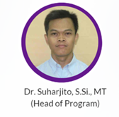
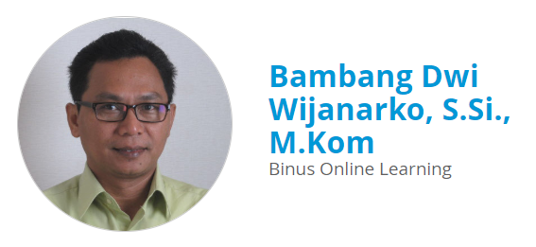
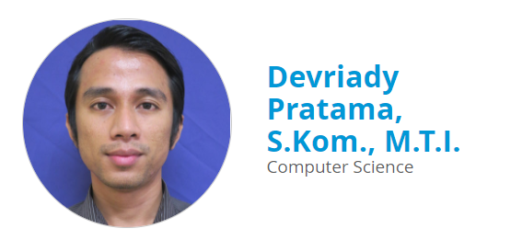
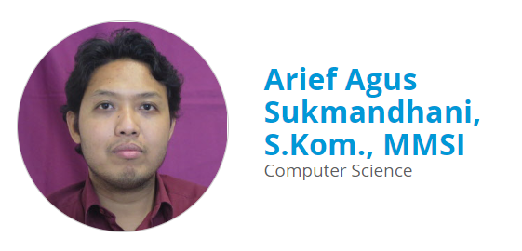
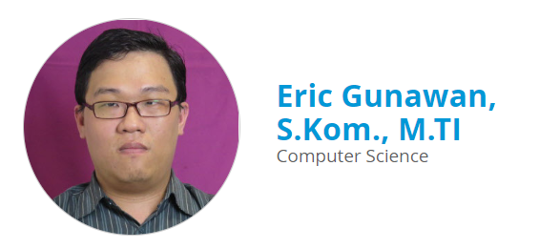
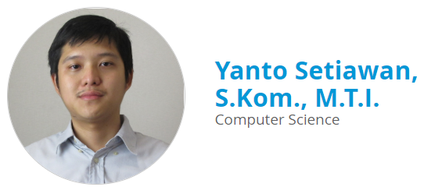
CS PJJ – Faculty Member

Slide 31
Terima Kasih
Suharjito (0812 8400 536)
(HOP PJJ-Teknik Informatika)
Novita Hanafiah (0858 8378 7771)
(Deputy HOP PJJ-Teknik Informatika)

